Slide 1
Introduction
Purpose of Database Systems
View of Data
Data Models
Data Definition Language
Data Manipulation Language

Slide 2
Data vs. Information
Data:
Raw facts; building blocks of information
Unprocessed information
Information:
Data processed to reveal meaning
Accurate, relevant, and timely information is key for good decision making
Good decision making is the key for survival in a global environment

Slide 3
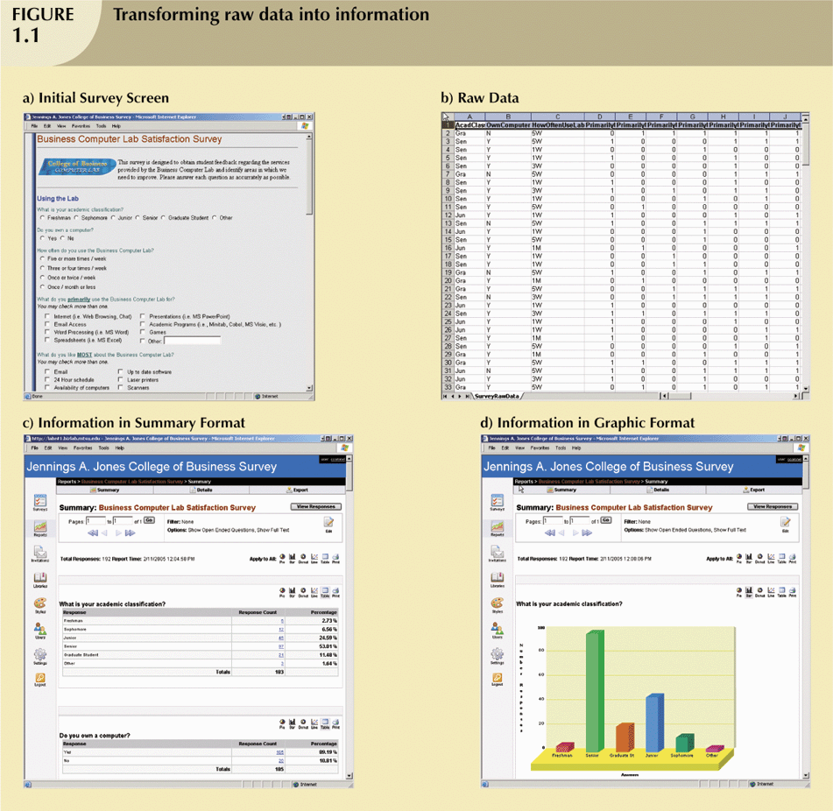
Transforming Raw Data into Information

Slide 4
Transforming Raw Data into Information (continued)

Slide 5
Transforming Raw Data into Information (continued)

Slide 6
Transforming Raw Data into Information (continued)

Slide 7
Introducing the Database and the DBMS
Database—shared, integrated computer structure that stores:
End user data (raw facts)
Metadata (data about data)

Slide 8
Introducing the Database and the DBMS (continued)
DBMS (database management system):
Collection of programs that manages database structure and controls access to data
Possible to share data among multiple applications or users
Makes data management more efficient and effective

Slide 9
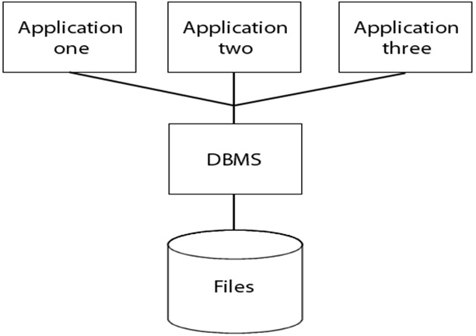
Role and Advantages of the DBMS (continued)

Slide 10
Database Management System (DBMS)
Database Applications:
Banking: all transactions
Airlines: reservations, schedules
Universities: registration, grades
Sales: customers, products, purchases
Manufacturing: production, inventory, orders, supply chain
Human resources: employee records, salaries, tax deductions
Databases touch all aspects of our lives

Slide 11
Role and Advantages of the DBMS (continued)
End users have better access to more and better-managed data
Promotes integrated view of organization’s operations
Probability of data inconsistency is greatly reduced
Possible to produce quick answers to ad hoc queries

Slide 12
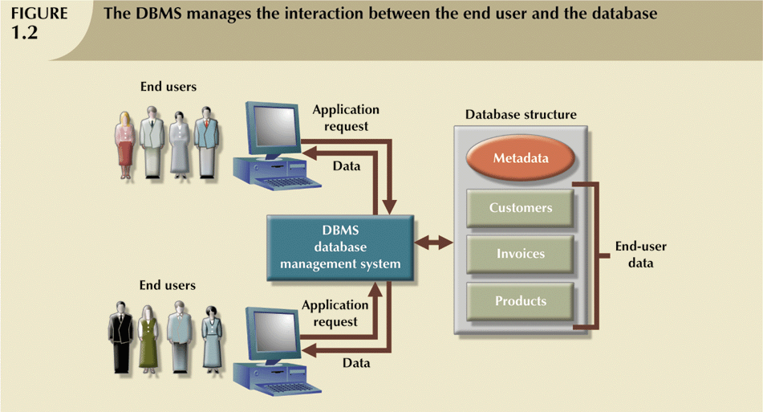
Role and Advantages of the DBMS (continued)

Slide 13
Types of Databases
Single-user:
Supports only one user at a time
Desktop:
Single-user database running on a personal computer
Multi-user:
Supports multiple users at the same time

Slide 14
Types of Databases (continued)
Workgroup:
Multi-user database that supports a small group of users or a single department
Enterprise:
Multi-user database that supports a large group of users or an entire organization

Slide 15
Types of Databases (continued)
Can be classified by location:
Centralized:
Supports data located at a single site
Distributed:
Supports data distributed across several sites

Slide 16
Types of Databases (continued)
Can be classified by use:
Transactional (or production):
Supports a company’s day-to-day operations
Data warehouse:
Stores data used to generate information required to make tactical or strategic decisions
Often used to store historical data
Structure is quite different

Slide 17
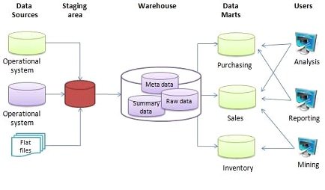
The basic architecture of a data warehouse
Extract, transform, load (ETL)
Extract, load, transform (E-LT)

Slide 18

Purpose of Database System
Office Records ort File Systems

Slide 19
Why Database Design is Important
Defines the database’s expected use
Different approach needed for different types of databases
Avoid redundant data
Poorly designed database generates errors → leads to bad decisions → can lead to failure of organization

Slide 20
Purpose of Database System
In the early days, database applications were built on top of file systems

Slide 21
Purpose of Database System
Drawbacks of using file systems to store data:
Data redundancy and inconsistency
Multiple file formats, duplication of information in different files
Difficulty in accessing data
Need to write a new program to carry out each new task
Data multiple files and formats
Integrity problems
Integrity constraints (e.g. account balance > 0) become part of program code
Hard to add new constraints or change existing ones

Slide 22
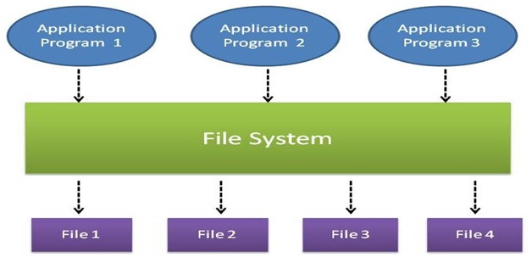
Historical Roots: Files and File Systems (continued)

Slide 23
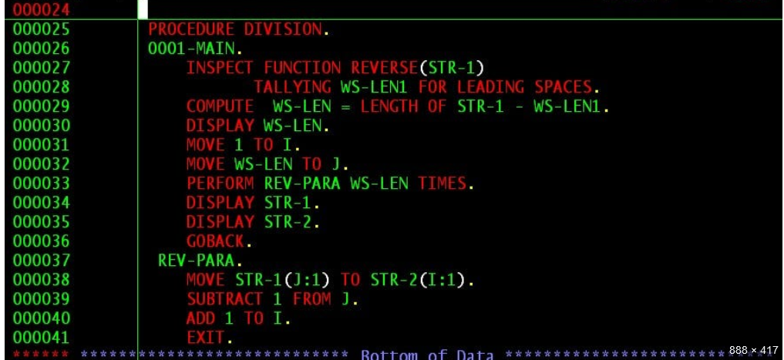
COBOL Example

Slide 24
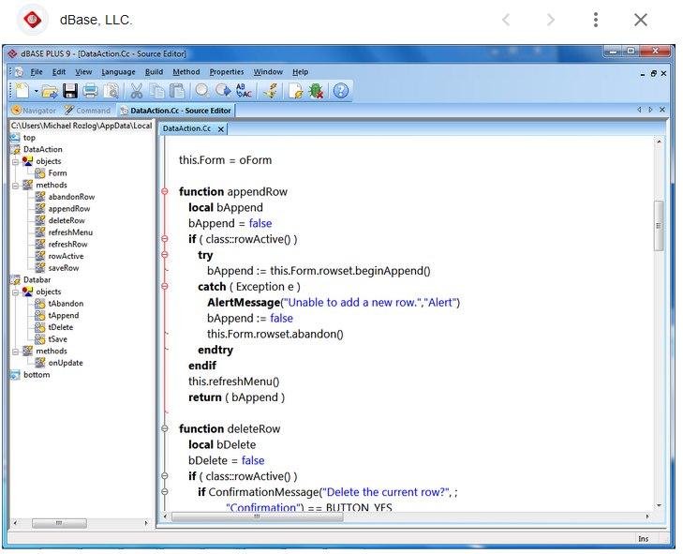


Slide 25
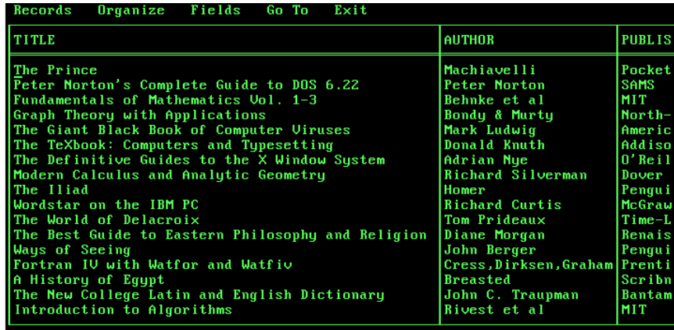

Slide 26
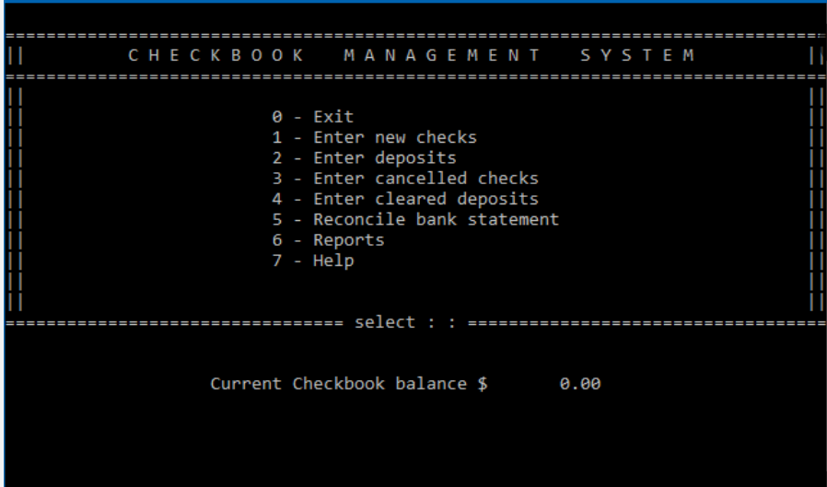

Slide 27
Purpose of Database Systems (Cont.)
Drawbacks of using file systems (cont.)
Atomicity of updates
Failures may leave database in an inconsistent state with partial updates carried out
E.g. transfer of funds from one account to another should either complete or not happen at all
Concurrent access by multiple users
Concurrent accessed needed for performance
Uncontrolled concurrent accesses can lead to inconsistencies
E.g. two people reading a balance and updating it at the same time
Security problems
Database systems offer solutions to all the above problems

Slide 28
Historical Roots: Files and File Systems
Managing data with file systems is obsolete
Understanding file system characteristics makes database design easier to understand
Awareness of problems with file systems helps prevent similar problems in DBMS
Knowledge of file systems is helpful if you plan to convert an obsolete file system to a DBMS

Slide 29
Historical Roots: Files and File Systems (continued)
Manual File systems:
Collection of file folders kept in file cabinet
Organization within folders based on data’s expected use (ideally logically related)
System adequate for small amounts of data with few reporting requirements
Finding and using data in growing collections of file folders became time-consuming and cumbersome

Slide 30
Historical Roots: Files and File Systems (continued)
Conversion from manual to computer system:
Could be technically complex, requiring hiring of data processing (DP) specialists
Initially, computer files were similar in design to manual files

Slide 31
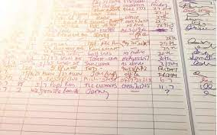
Historical Roots: Files and File Systems (continued)

Slide 32
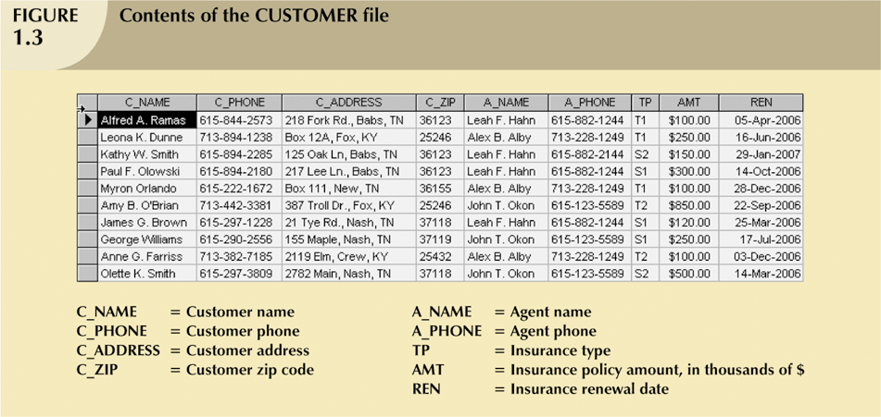
Historical Roots: Files and File Systems (continued)

Slide 33
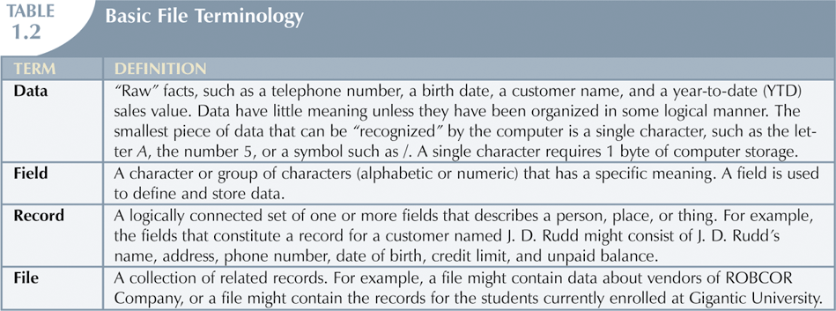
Historical Roots: Files and File Systems (continued)

Slide 34
Historical Roots: Files and File Systems (continued)
DP specialist wrote programs for reports:
Monthly summaries of types and amounts of insurance sold by agents
Monthly reports about which customers should be contacted for renewal
Reports that analyzed ratios of insurance types sold by agent
Customer contact letters summarizing coverage

Slide 35
Historical Roots: Files and File Systems (continued)
Other departments requested databases be written for them
SALES database created for sales department
AGENT database created for personnel department

Slide 36
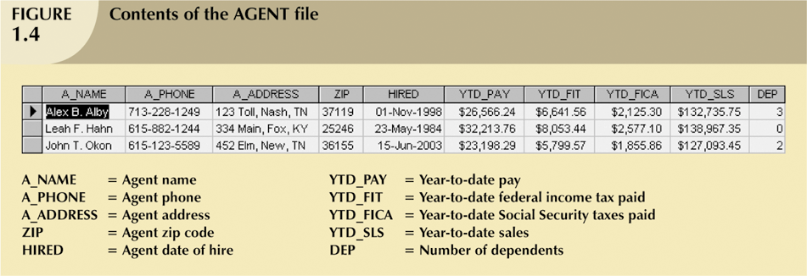
Historical Roots: Files and File Systems (continued)

Slide 37
Historical Roots: Files and File Systems (continued)
As number of databases increased, small file system evolved
Each file used its own application programs
Each file was owned by individual or department who commissioned its creation

Slide 38
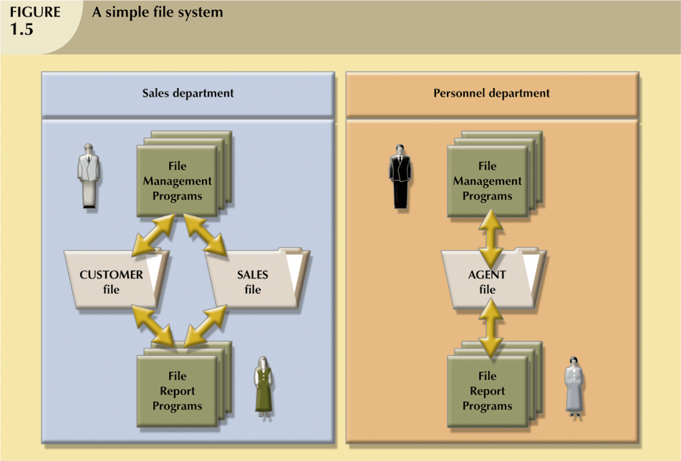
Historical Roots: Files and File Systems (continued)

Slide 39
Example of Early Database Design (continued)
As system grew, demand for DP’s programming skills grew
Additional programmers hired
DP specialist evolved into DP manager, supervising a DP department
Primary activity of department (and DP manager) remained programming

Slide 40
Problems with File System Data Management
Every task requires extensive programming in a third-generation language (3GL)
Programmer must specify task and how it must be done
Modern databases use fourth-generation languages (4GL)
Allow users to specify what must be done without specifying how it is to be done

Slide 41
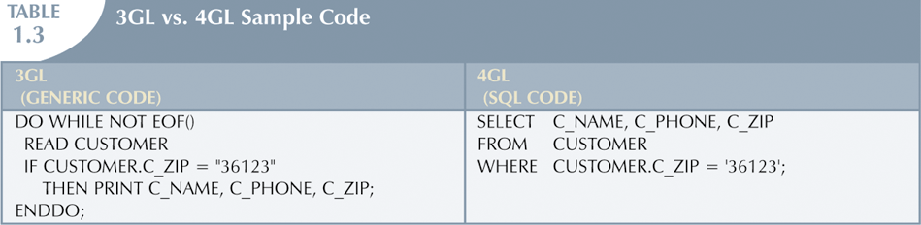
Problems with File System Data Management

Slide 42
Problems with File System Data Management
Time-consuming, high-level activity
As number of files expands, system administration becomes difficult
Making changes in existing file structure is difficult
File structure changes require modifications in all programs that use data in that file

Slide 43
Problems with File System Data Management
Modifications are likely to produce errors, requiring additional time to “debug” the program
Security features hard to program and therefore often omitted

Slide 44
Structural and Data Dependence
Structural dependence
Access to a file depends on its structure

Slide 45
Structural and Data Dependence (continued)
Data dependence
Changes in the data storage characteristics without affecting the application program’s ability to access the data
Logical data format
How the human being views the data
Physical data format
How the computer “sees” the data

Slide 46
Field Definitions and Naming Conventions
Flexible record definition anticipates reporting requirements by breaking up fields into their component parts

Slide 47
Database Systems
Problems inherent in file systems make using a database system desirable
File system
Many separate and unrelated files
Database
Logically related data stored in a single logical data repository

Slide 48
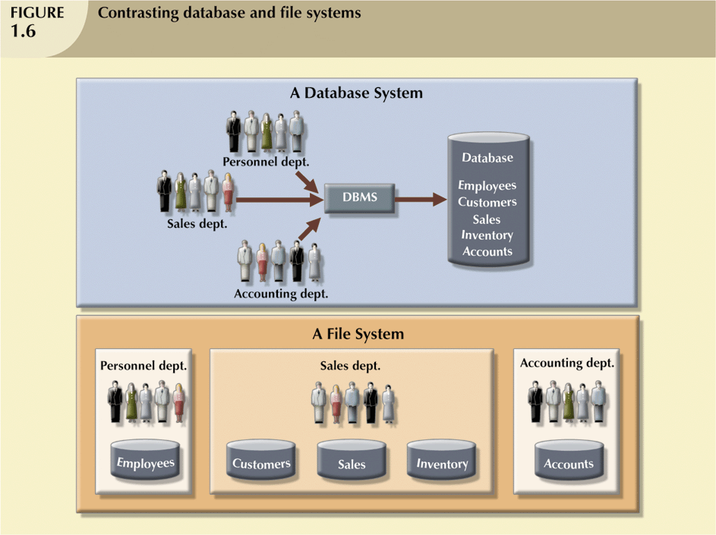
Database Systems

Slide 49
The Database System Environment
Database system is composed of five main parts:
Hardware
Software
Operating system software
DBMS software
Application programs and utility software
People
Procedures
Data

Slide 50
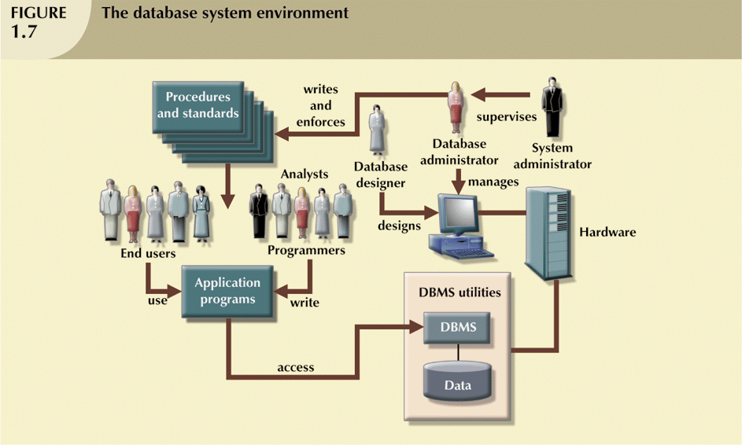
The Database System Environment (continued)

Slide 51
DBMS Functions
DBMS performs functions that guarantee integrity and consistency of data
Data dictionary management
defines data elements and their relationships
Data storage management
stores data and related data entry forms, report definitions, etc.

Slide 52
DBMS Functions (continued)
Data transformation and presentation
translates logical requests into commands to physically locate and retrieve the requested data
Security management
enforces user security and data privacy within database

Slide 53
DBMS Functions (continued)
Multiuser access control
uses sophisticated algorithms to ensure multiple users can access the database concurrently without compromising the integrity of the database
Backup and recovery management
provides backup and data recovery procedures
Data integrity management
promotes and enforces integrity rules

Slide 54
DBMS Functions (continued)
Database access languages and application programming interfaces
provide data access through a query language
Database communication interfaces
allow database to accept end-user requests via multiple, different network environments

Slide 55
Data Abstraction
Major aim of a DBMS is to provide users with an abstract view of data
Hides certain details of how the data are stored & maintained
DBMS must retrieve data efficiently
Need for efficiency has led designers to use complex data structures to represent the data in the database
Most DB users are not computer trained, developers hide complexity through several levels of abstraction to simplify user’s interaction with the systems

Slide 56
Levels of Abstraction
Physical level describes how a record (e.g., customer) is stored.
Logical level: describes data stored in database, and the relationships among the data.
type customer = record name : string; street : string; city : integer; end;
View level: application programs hide details of data types. Views can also hide information (e.g., salary) for security purposes.

Slide 57
3 Levels of Abstraction
Logical or Conceptual Level
Describes what data are stored in the DB & what relationships exist among those data
Describes the entire DB in terms of relatively simpler structures
Implementation of these simple structures at this level may involve complex physical-level structures
Users of the logical level need not be aware of this complexity
DBAs, who decide what information to keep in DB, use the logical level of abstraction

Slide 58
Levels of Abstraction
Many views, single conceptual (logical) schema and physical schema.
Views describe how users see the data.
Conceptual schema defines logical structure
Physical schema describes the files and indexes used.
View 1
View 2
View 3
Conceptual Schema
Physical Schema
Schemas are defined using DDL; data is modified/queried using DML.

Slide 59
ANSI/SPARC 3-Tier Architecture
User 1
User 2
User n
External Level
View 1
View 2
…
View n
E/C Mapping
Logical DI
Conceptual/Logical Level
Conceptual Schema
Physical DI
C/I Mapping
Internal Level
Physical Schema
Database

Slide 60
Instances & Schemas
Collection of information stored in the DB at a particular moment is called an INSTANCE
The overall design of the DB is called a SCHEMA
A DB has many schemas
Physical
Conceptual/Logical
Sub-schemas

Slide 61
Example: University Database
Logical schema:
Students(sid: string, name: string, login: string, age: integer, gpa:real)
Faculty(fid:string, fname:string, sal:real)
Courses(cid: string, cname:string, credits:integer)
Enrolled(sid:string, cid:string, grade:string)
Physical schema:
Relations stored as unordered files.
Index on first column of Students.
External Schema (View):
Course_info(cid:string,fname:string, enrollment:integer)
Notes:
7

Slide 62
Data Models
A collection of tools for describing
data
data relationships
data semantics
data constraints
Entity-Relationship model
Relational model
Other models:
object-oriented model
semi-structured data models
Older models: network model and hierarchical model

Slide 63
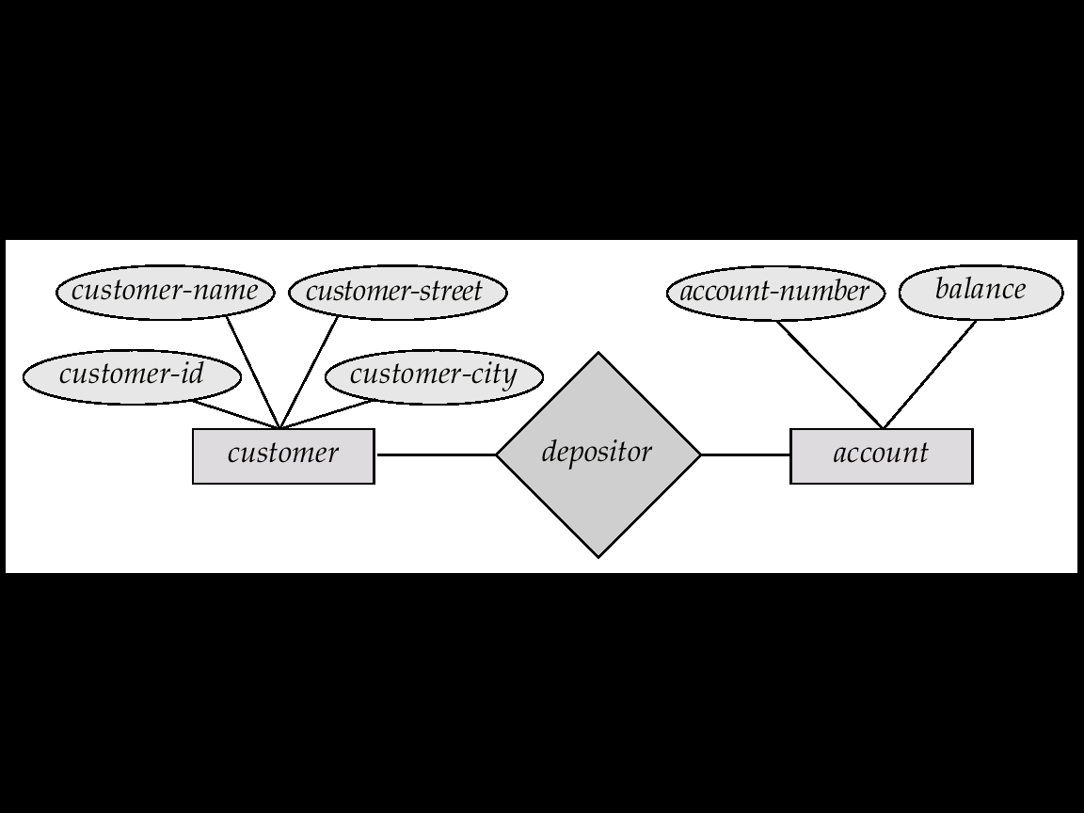
Entity-Relationship Model
Example of schema in the entity-relationship model

Slide 64
Entity Relationship Model (Cont.)
E-R model of real world
Entities (objects)
E.g. customers, accounts, bank branch
Relationships between entities
E.g. Account A-101 is held by customer Johnson
Relationship set depositor associates customers with accounts
Widely used for database design
Database design in E-R model usually converted to design in the relational model (coming up next) which is used for storage and processing

Slide 65
Relational Model
Attributes
Example of tabular data in the relational model
customer-
name
customer-
street
customer-
city
account-
number
Customer-id
192-83-7465
019-28-3746
192-83-7465
321-12-3123
019-28-3746
Johnson
Smith
Johnson
Jones
Smith
Alma
North
Alma
Main
North
A-101
A-215
A-201
A-217
A-201
Palo Alto
Rye
Palo Alto
Harrison
Rye

Slide 66
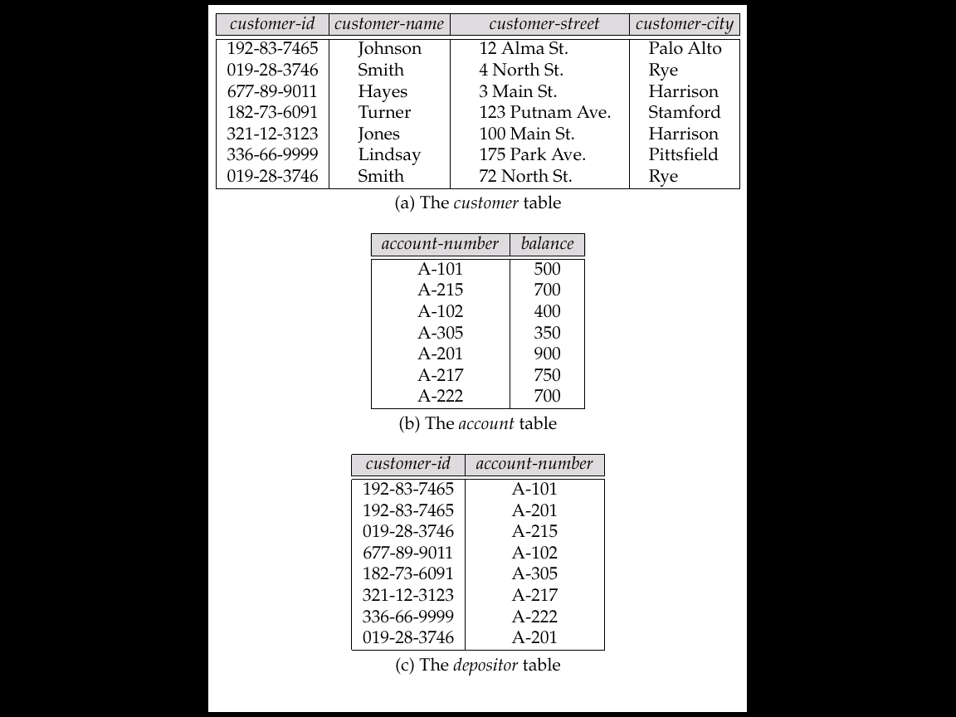
A Sample Relational Database

Slide 67
Data Definition Language (DDL)
Specification notation for defining the database schema
E.g. create table account ( account-number char(10), balance integer)
DDL compiler generates a set of tables stored in a data dictionary
Data dictionary contains metadata (i.e., data about data)
database schema
Data storage and definition language
language in which the storage structure and access methods used by the database system are specified
Usually an extension of the data definition language

Slide 68
Data Manipulation Language (DML)
Language for accessing and manipulating the data organized by the appropriate data model
DML also known as query language
Two classes of languages
Procedural – user specifies what data is required and how to get those data
Nonprocedural – user specifies what data is required without specifying how to get those data
SQL is the most widely used query language

Slide 69
SQL
SQL: widely used non-procedural language
E.g. find the name of the customer with customer-id 192-83-7465 select customer.customer-name from customer where customer.customer-id = ‘192-83-7465’
E.g. find the balances of all accounts held by the customer with customer-id 192-83-7465 select account.balance from depositor, account where depositor.customer-id = ‘192-83-7465’ and depositor.account-number = account.account-number
Application programs generally access databases through one of
Language extensions to allow embedded SQL
Application program interface (e.g. ODBC/JDBC) which allow SQL queries to be sent to a database

Slide 70
Database Users
Users are differentiated by the way they expect to interact with the system
Application programmers – interact with system through DML calls
Sophisticated users – form requests in a database query language
Specialized users – write specialized database applications that do not fit into the traditional data processing framework
Naïve users – invoke one of the permanent application programs that have been written previously
E.g. people accessing database over the web, bank tellers, clerical staff

Slide 71
Database Administrator
Coordinates all the activities of the database system; the database administrator has a good understanding of the enterprise’s information resources and needs.
Database administrator's duties include:
Schema definition
Storage structure and access method definition
Schema and physical organization modification
Granting user authority to access the database
Specifying integrity constraints
Acting as liaison with users
Monitoring performance and responding to changes in requirements

Slide 72
Transaction Management
A transaction is a collection of operations that performs a single logical function in a database application
Transaction-management component ensures that the database remains in a consistent (correct) state despite system failures (e.g., power failures and operating system crashes) and transaction failures.
Concurrency-control manager controls the interaction among the concurrent transactions, to ensure the consistency of the database.

Slide 73
Storage Management
Storage manager is a program module that provides the interface between the low-level data stored in the database and the application programs and queries submitted to the system.
The storage manager is responsible to the following tasks:
interaction with the file manager
efficient storing, retrieving and updating of data

Slide 74
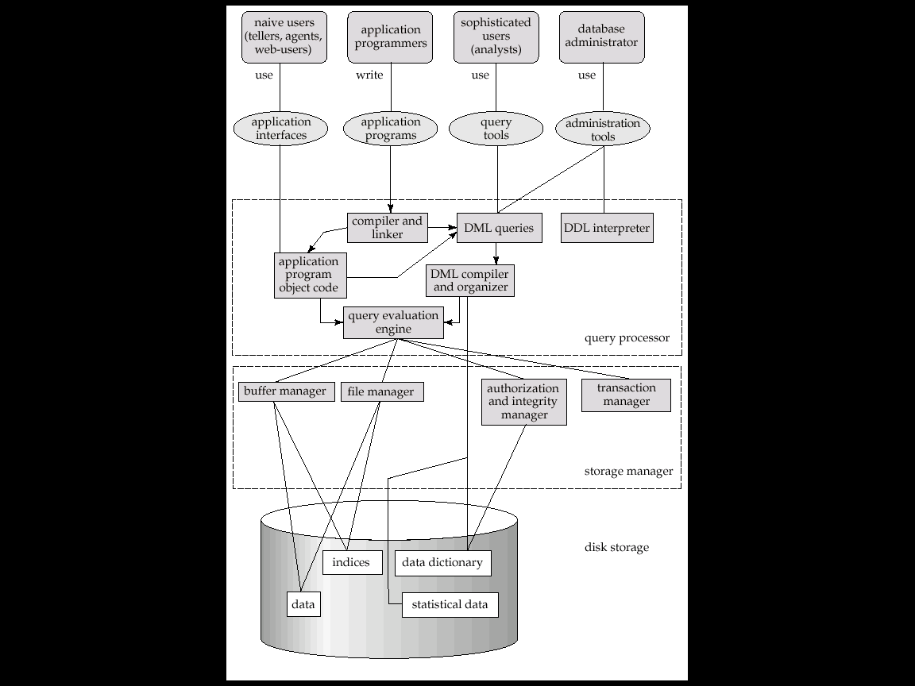
Overall System Structure

Slide 75
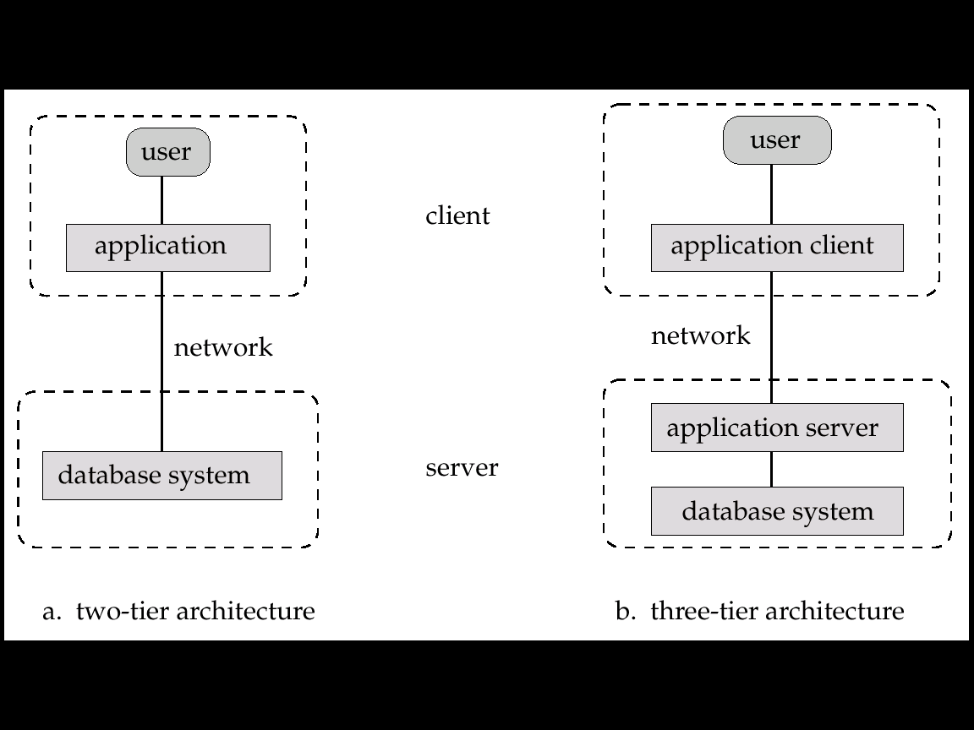
Application Architectures
Two-tier architecture: E.g. client programs using ODBC/JDBC to communicate with a database
Three-tier architecture: E.g. web-based applications, and applications built using “middleware”

Slide 76
https://www.includehelp.com/dbms/dbms-vs-traditional-file-system.aspx
https://www.guru99.com/difference-between-file-system-and-dbms.html

